Slide 1
Mission: Azure Kubernetes Service
Carlos Mendible - @cmendibl3

Slide 2
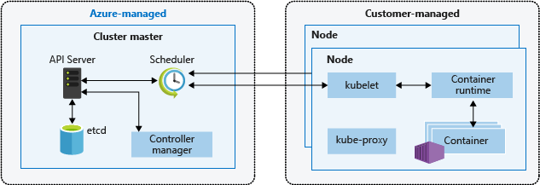
AKS: Architecture
Cluster master nodes provide the core Kubernetes services and orchestration of application workloads & are managed by Azure
You cannot access the master nodes directly
Custom Ubuntu flavor
4 minor versions of k8s
Notes:
Master
Access to the API server must be controlled using RBAC and Azure Active Directory.
Nodes
The Azure platform automatically applies OS security patches to the nodes on a nightly basis.
Nodes are deployed into a private virtual network subnet, with no public IP addresses assigned.
The data stored in the nodes managed disks is automatically encrypted at rest within the Azure platform.

Slide 3
AKS: Limits & Resource Reservations
Max clusters per subscription: 100
Max nodes per cluster: 100
Max pods per node: Basic Networking: 110
Max pods per node: Advanced Networking : 110
CPU 60 ms
Memory 20% up to 4 GiB

Slide 4
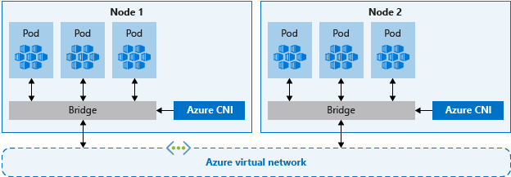
AKS: Networking
Basic networking
The Azure platform manages the network configuration of the cluster and pods.
With basic networking, you can't define network configuration such as subnet names or the IP address ranges assigned to the AKS cluster.
Nodes in an AKS cluster configured for basic networking use the kubenet Kubernetes plugin.
Expose a Kubernetes service externally or internally through the Azure Load Balancer.
Pods can access resources on the public Internet.
Advanced networking
Advanced networking places your pods in an Azure virtual network that you configure.
Better performance than basic networking
Notes:
https://docs.microsoft.com/en-us/azure/aks/operator-best-practices-network
Nodes in an AKS cluster configured for advanced networking use the Azure Container Networking Interface (CNI) Kubernetes plugin.

Slide 5
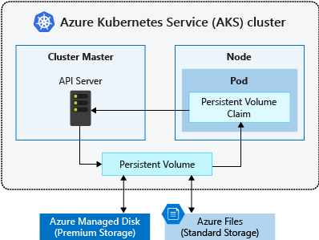
AKS: Storage
Azure Disks:
Use Premium storage.
Mounted as ReadWriteOnce, so are only available to a single node
Azure Files:
Only use Azure Standard storage backed by regular HDDs
Used to mount a SMB 3.0 share backed by an Azure Storage account to pods. Files let you share data across multiple nodes and pods.
Notes:
https://docs.microsoft.com/en-us/azure/aks/operator-best-practices-storage

Slide 6
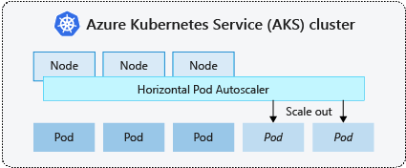
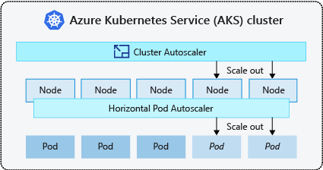
AKS: Scale
Horizontal pod autoscaler
AKS uses the horizontal pod autoscaler (HPA) to monitor the resource demand and automatically scale the number of replicas.
Needs Requests & Limits specified for the containers.
Cluster autoscaler
Works on RBAC-enabled clusters

Slide 7
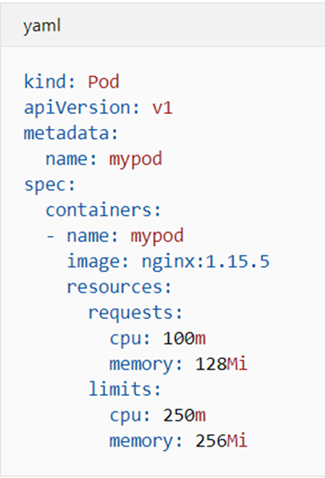
AKS: Pod requests and limits
Pod requests
amount of CPU and memory that the pod needs.
Pod limits
Maximum amount of CPU and memory that a pod can use.
Notes:
Pod requests define a set amount of CPU and memory that the pod needs. These requests should be the amount of compute resources the pod needs to provide an acceptable level of performance.
Pod limits are the maximum amount of CPU and memory that a pod can use. These limits help prevent one or two runaway pods from taking too much CPU and memory from the node. This scenario would reduce the performance of the node and other pods that run on it.

Slide 8

Demo
Horizontal Pod Autoscaling

Slide 9


Slide 10
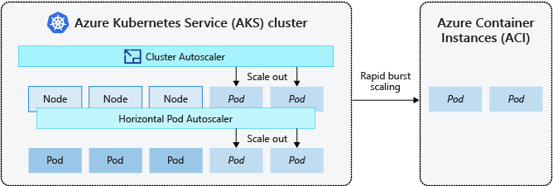
AKS: Burst out with ACI
Extend the cluster installing the Virtual Kubelet.
ACI lets you quickly deploy container instances without additional infrastructure overhead.

Slide 11

Demo
virtual-kubelet & ACI

Slide 12
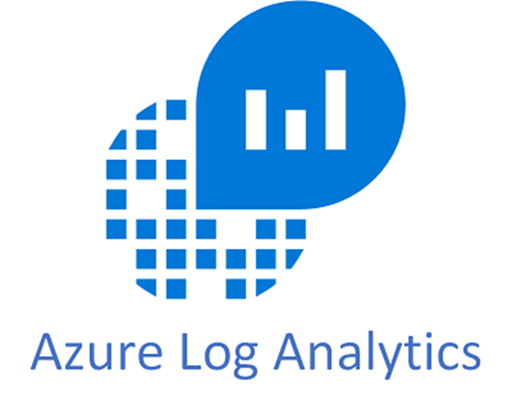
AKS: Monitoring and Logging
Requires Log Analytics Workspace.
Deploys a DaemonSet inside the cluster.
Grafana Integration

Slide 13

Demo
Monitoring and Grafana Integration

Slide 14
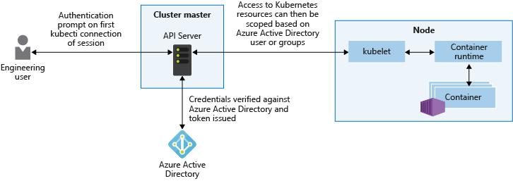
AKS: AAD Integration
Provides granular filtering of the actions that users can perform, using role-based access controls (RBAC).
Assign AAD groups to roles.

Slide 15
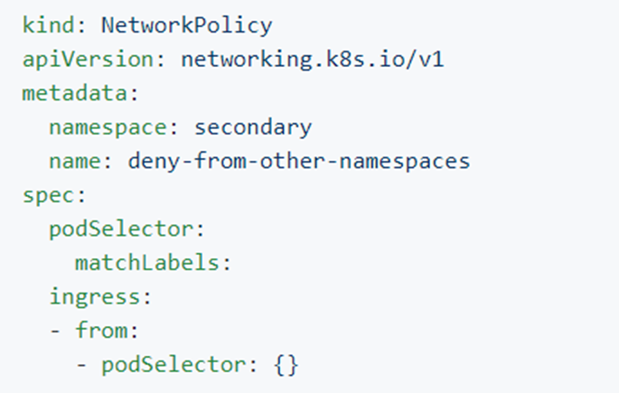
AKS: Network Policies (Preview)
All pods in an AKS cluster can send and receive traffic without limitations, by default
Secure traffic between pods using network policies
Choose to allow or deny traffic based on settings like assigned labels, namespace, or traffic port
Notes:
https://github.com/ahmetb/kubernetes-network-policy-recipes/blob/master/04-deny-traffic-from-other-namespaces.md

Slide 16
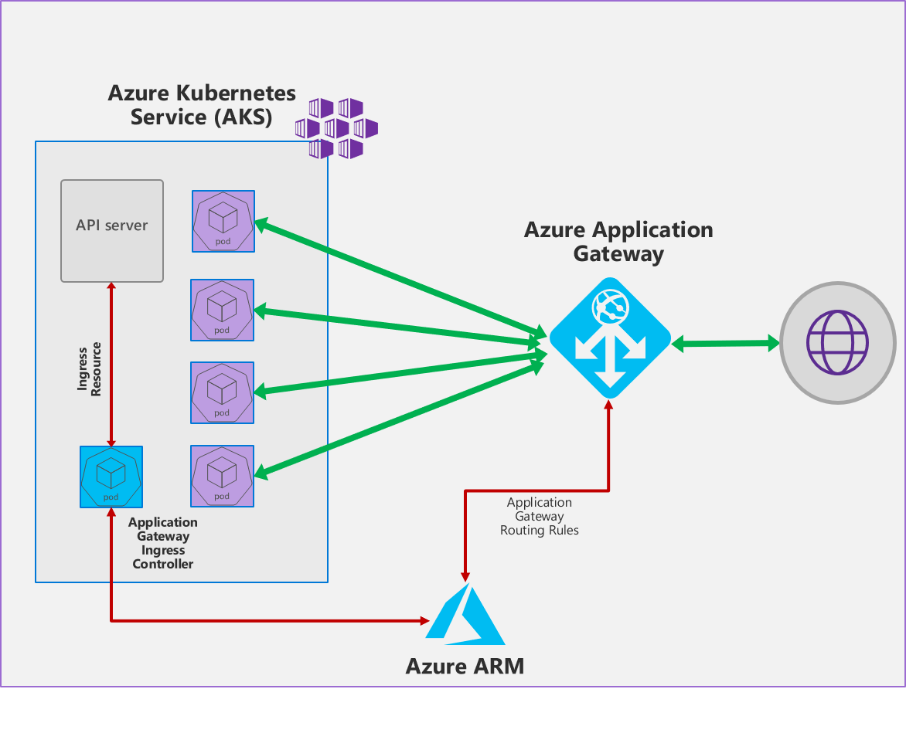
AKS: Ingress Controllers
AKS HTTP application routing feature: Azure platform creates the Ingress controller and an External-DNS
Use NGINX + Let's Encrypt
SSL/TLS termination
Azure Application Gateway Ingress Controller
WAF
Pod Managed Identity

Slide 17

AKS: Secrets
Use Azure Key Vault for secrets when needed:
Kubernetes-KeyVault-FlexVolume.
Pod Managed Identity (Preview)

Slide 18
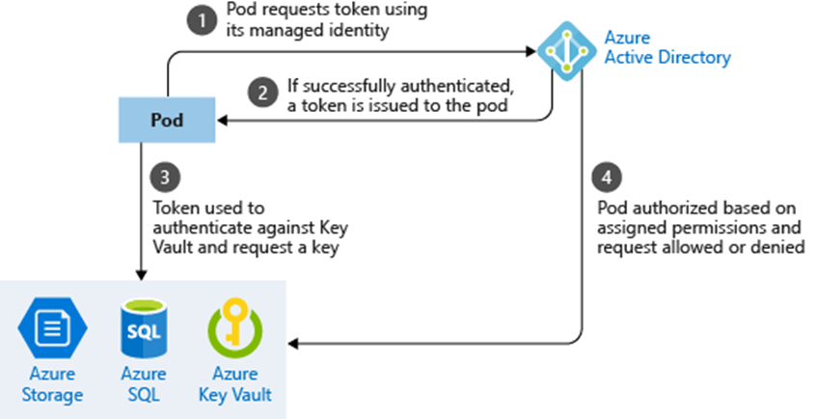
AKS: Use pod managed identities
The pod is assigned an Azure Identity that lets them authenticate to Azure Active Directory and receive a digital token.
The digital token can be presented to other Azure services that check if the pod is authorized to access the service and perform the required actions.

Slide 19

Demo
KeyVault: Pod Managed Identity

Slide 20
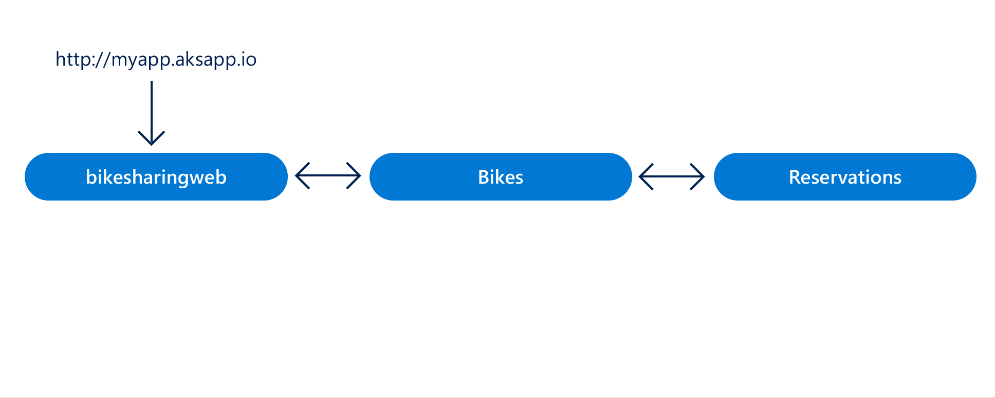
AKS: AZDS (Preview)
A rapid, iterative Kubernetes development experience for teams
Work directly in AKS
Iterate and debug using Visual Studio or Visual Studio Code.
Generate Docker and Kubernetes configuration-as-code assets.
Share a cluster with your team and collaboratively work together.
Develop your code in isolation, and do end-to-end testing with other components without replicating or mocking up dependencies.
Notes:
A rapid, iterative Kubernetes development experience for teams
Minimize local dev machine setup for each team member and work directly in AKS, a managed Kubernetes cluster in Azure.
Rapidly iterate and debug code directly in Kubernetes using Visual Studio 2017 or Visual Studio Code.
Generate Docker and Kubernetes configuration-as-code assets for you to use from development through to production.
Share a managed Kubernetes cluster with your team and collaboratively work together.
Develop your code in isolation, and do end-to-end testing with other components without replicating or mocking up dependencies.

Slide 21

Demo
Azure Dev Spaces

Slide 22

Call to Action

